Slide 1
DNN8 API Hidden Gems
Serge van der Ven
XCESS
serge.van.der.ven@xcess.nl
@sergevdven
Peter Donker
bring2mind
peter@bring2mind.net
@bring2mind

Slide 2
Please support our valuable sponsors

Slide 3
Revealing the DNN8 API Hidden Gems
In this session
Introduction
Module Settings API
Image Handler
Client Dependency Framework, featuring Peter Donker
Questions

Slide 4
Revealing the DNN8 API Hidden Gems
In this session
Introduction
Module Settings API
Image Handler
Client Dependency Framework
Questions

Slide 5
Introduction
Serge van der Ven
Husband, father of a son (12 yrs) and daughter (10 yrs), musician, skier, loves DNN, XCESS DNN consultant

Slide 6
Introduction
8
MVC
SPA
Notes:
Last year at DNN connect, lot of attention for MVC and SPA
Indeed both very valuable new additions to framework
Felt there was more
Are you ready to enter some of the hidden gems in the DNN8 API?

Slide 7
Revealing the DNN8 API Hidden Gems
In this session
Introduction
Module Settings API
Image Handler
Client Dependency Framework
Questions

Slide 8
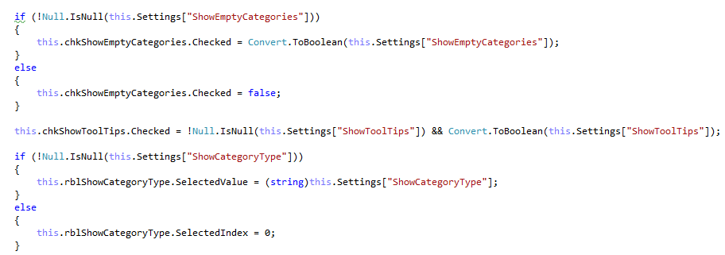
You should recognize this
Use string-keys
Conversions
Explicit defaults
Notes:
Sample from the DNN FAQ module

Slide 9
Lets see some hands
Who has ever
had errors due to typos in the setting names?
had errors due to conversion mismatch in load and save?
build a custom wrapper around module settings?
incorporated such wrapper into a custom library (assembly)?

Slide 10
Wouldn’t it be great
If you could
use settings just as a (strongly) typed entity (object)?
define a single class with properties for your settings?
have an intuitive interface to load, use and save settings?

Slide 11
Yes you can!
With the DNN8 Module Settings API you:
no longer need to use strings to load and save settings!
no longer need to convert settings to and from strings!
can use strongly types setting objects in your code!
can combine Module- / TabModule- and PortalSettings all in one!
still have complete control over (de-)serialization!
Notes:
De-seialization only when explicitly needed, becasue its provided out of the box by the Module Settings API

Slide 12
A little bit of background
Settings are present in DNN as of the early days
Basically key/value pairs (both strings)
Comes in four flavors
Host Settings
Portal Settings
Module Settings
TabModule Settings
Persist (module) behavior and instance specific data
“Thou shall not persist content in settings”
Notes:
Explain the difference between TabModule settings and ModuleSettings
Explain that HostSettings need not to be used by module developers > You can, but it should be minimum.

Slide 13
Define a new Module Settings API
Inspired by OR/Ms like
EntityFramework
nHybernate
DNN DAL2
Use attributes to define behavior
Promote DNN patterns like repository
Should be easy to understand and easy to use
Notes:
We looking at a new Module Settings API => inspired by OR/M
Little rework for developers to use the new API

Slide 14
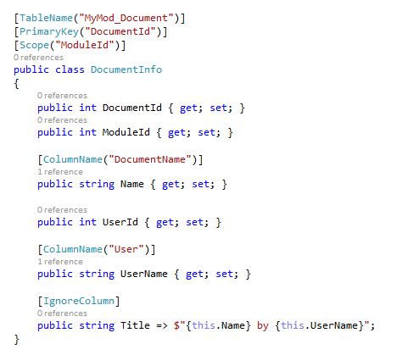
Inspiration: DNN DAL vs. DAL2
Attribute based!

Slide 15
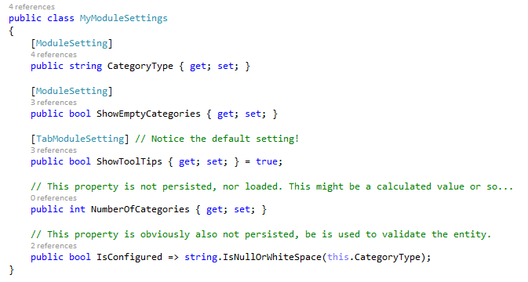
Result: DAL2 vs. Module Settings”2”
Use TabModule settings for presentation behavior
Notes:
Explain the difference: DAL2: Explict Ignore, ModuleSettings, Explicit Include
Result: Single class (POCO) to hold all settings! Just use attributes!

Slide 16
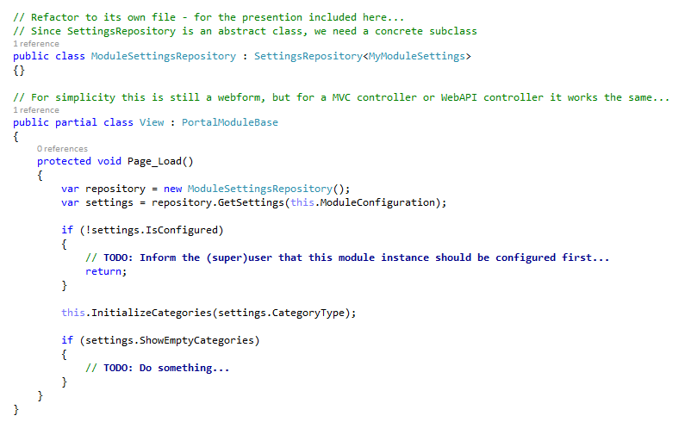
Easy to understand and simple to use!
You must subclass SettingsRepository
ModuleInfo type
Notes:
Notice that the Repository actually instantiates the POCO class

Slide 17
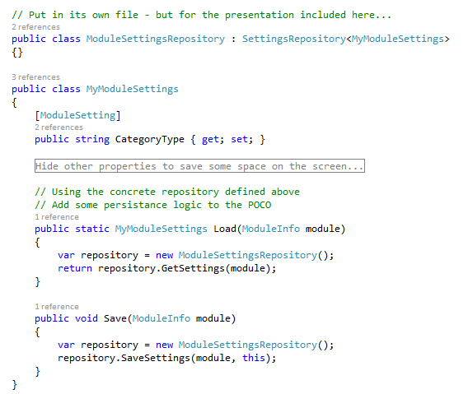
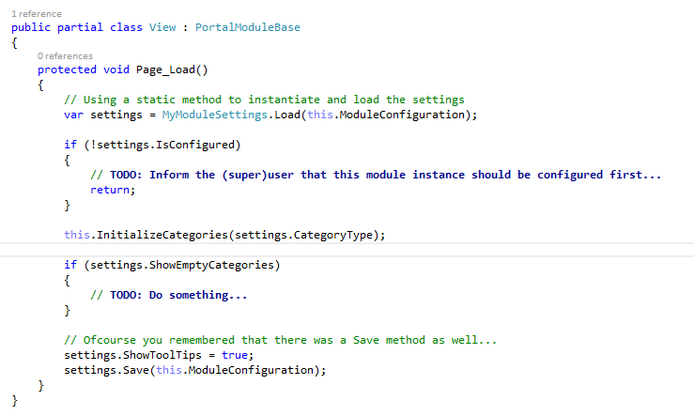
DNN Repository pattern!

Slide 18
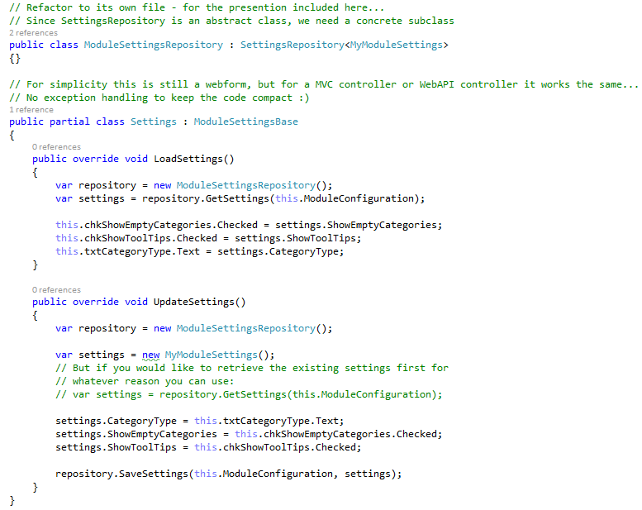
Easy to use – Settings Control
Your Settings control hardly need to be modified…

Slide 19
So… what’s in the box?
abstract class
stores mappings
and caches settings
Your module
DNN Platform
SettingsRepository<POCO>
Your settings (POCO)
(DNN)Cache
ModuleSetting attribute
Mapper
TabModuleSetting attribute
maps properties to Setting attributes
PortalSetting attribute

Slide 20
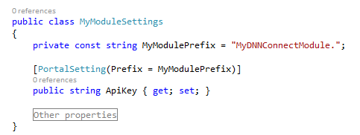
But wait… there is more!
Custom naming
e.g. for backward compatibility
Naming prefixing
e.g. to avoid naming conflicts
Use more constants ☺

Slide 21
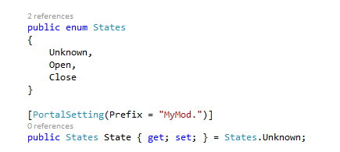
And more…
Default values
for nullables or non-nullables
Enum values
without a custom (de)serializer
Notes:
Enum types support int and string dependent on how setting was persisted

Slide 22
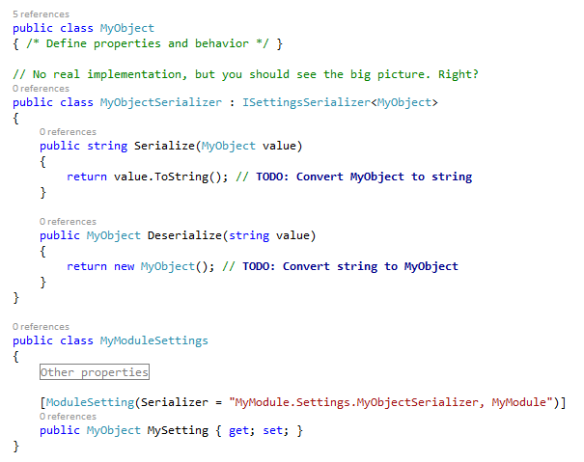
And even more…
Custom (de)serialization
e.g. efficiently (de)serialize custom objects
Any class that implements ISettingsSerializer

Slide 23
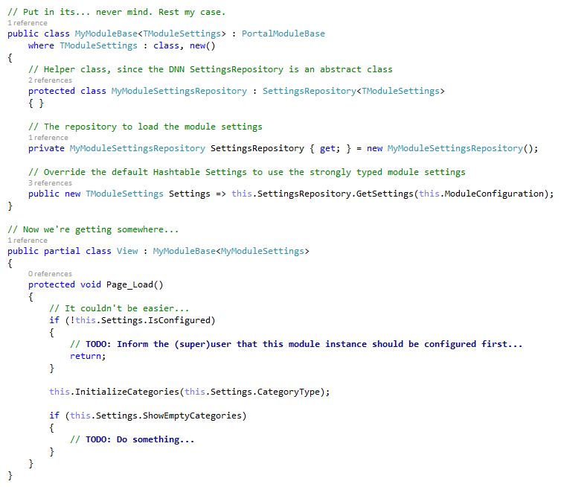
One small wrapper for [a] man…
Use a (generic) base class to wrap your settings handling
Notes:
TIP / ADVICE

Slide 24
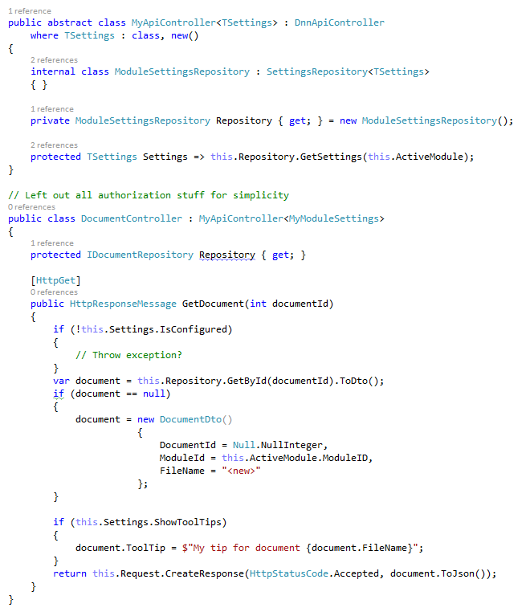
Module Settings API and WebAPI
Again:
Use a (generic) base class to wrap your settings handling
Notes:
For MVC and SPA: in the WebAPIController use a base class as well.

Slide 25
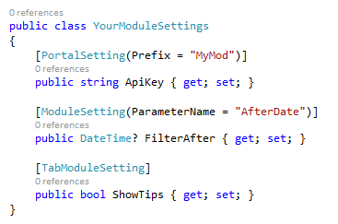
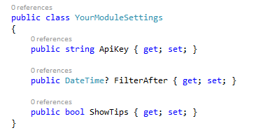
Wrapped up
Start using the Module Settings API!
Define your POCO
Add some attributes
Subclass the SettingsRepository
Decide how to use the Repository
standalone
within the POCO
Your code will be cleaner and more stable!
Start using it now!

Slide 26
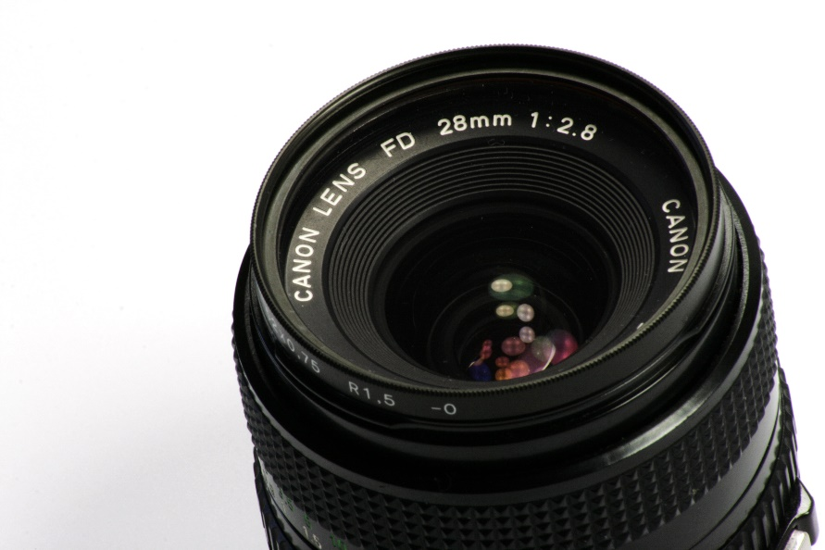
Resources – your picture moment
Module Settings API
Folder location in DNN Platform solution:
DotNetNuke.Library\Entities\Modules\Settings
https://github.com/dnnsoftware/Dnn.Platform

Slide 27
Revealing the DNN8 API Hidden Gems
In this session
Introduction
Module Settings API
Image Handler
Client Dependency Framework
Questions

Slide 28
Lets see some hands
<img src=“ProductA.jpg” width=“120px” height=“120px” />
Context:
Listing of products with thumbnails

Slide 29
Lets see some hands - outcome
<img src=“ProductA.jpg” width=“120px” height=“120px” />
This code is in principle good
unless
The source image is large, e.g. 1MB – 10MB
The source image does not exist

Slide 30
Wouldn’t it be great
If you could
quickly add image rendering capabilities to your module
render images without any [image] coding
render a default image if the requested image is not found
apply basic transformations the image
resize
rotate
…

Slide 31
Yes you can!
With the DNN8 Image Handler you can:
control the images to be loaded (types, permissions)
process the images once loaded
Transformations like resize, rotate, image adjustments etc.
cache (client-side and/or server side) processed images

Slide 32
Time to rewrite
<img src=“ProductA.jpg” width=“120px” height=“120px” />
<img src=“/dnnimagehandler.ashx? mode=securefile&fileid=2451&w=120&h=120” />

Slide 33
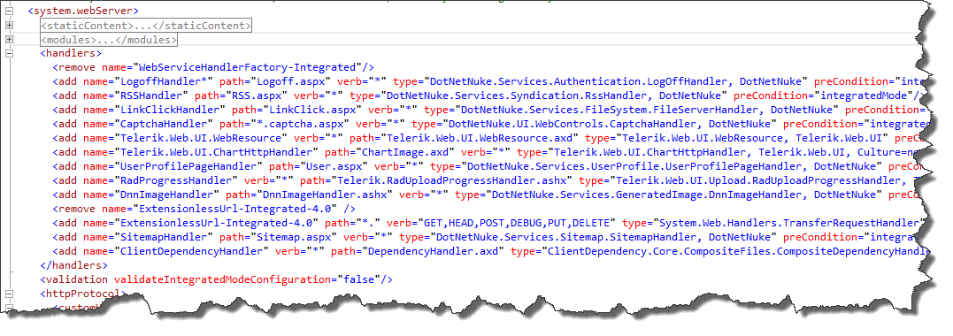
So you handle HTTP(s)
The DnnImageHandler is in fact a HttpHandler
Any class that implements IHttpHandler interface
It is initiated by a request, instantiated and called by IIS
It is registered in the (DNN) web.config

Slide 34
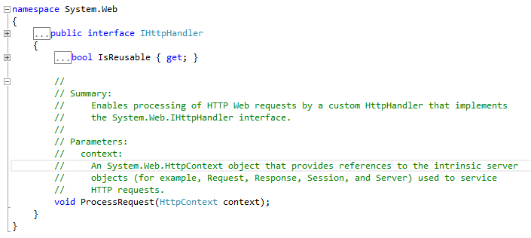
So you handle HTTP(s) - continued
HttpContext (w/ Request & Response) is passed to the handler
The handler
parses the request (QueryString) to determine the requested behavior
renders the content (i.e. the image)

Slide 35
It works with: TRANSFORMATIONS
First transformation (Start) loading of the image
Subsequent transformation(s) image processing
by URL QueryString arguments
ForEach(Transformation) Image IN, Image OUT
empty Image
“Load”
Proces 1
Proces 2
Proces n
Final Image
Image’
Image’’
Image’’’

Slide 36
Start Transformation
Five “operational” modes
profilepic (default)
placeholder
securefile
File / Url
custom
Custom mode is defined in web.config AppSettings
“DnnImageHandler.mode”
Value is a fully qualified class name and this concrete class should be subclass of ImageTransform
Example of a custom mode? Product Catalog!
Load a product image from a custom tabel or database

Slide 37
Available Transformations DNN8(.0.3)
Gamma
Greyscale
Invert
RotateFlip
Resize
Brightness
Contrast
Transformations are included based on QueryString arguments
Transformations are run in the shown order
Transformations can defined their own parameters (i.e. QueryString arguments

Slide 38
Examples
Start
Resize
RotateFlip
notice: for readability the URLs are not encoded.

Slide 39
Wrapped up
Start using the DNN8 Image Handler!
Simple URL syntax, using query string parameters
Ability to specify a default image
Use in your own module or in plain HTML (module/template)
With great power comes great responsibility
Don’t overuse
Usually not needed for button images
Possibilities for future extensions:
Watermark transformation
Tracking of images
Don’t reinvent the wheel, get on board now!

Slide 40
Resources – your picture moment
Image Handler
Folder location in DNN Platform solution:
DotNetNuke.Library\Services\GeneratedImage
check DnnImageHandler.cs for all QueryString parameters!
https://github.com/dnnsoftware/Dnn.Platform

Slide 41
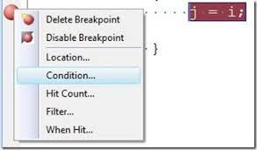
Revealing the DNN8 Hidden Gems
In this session
Introduction
Module Settings API
Image Handler
Client Dependency Framework, featuring Peter Donker
Questions
Notes:
Hit a breakpoint…

Slide 42
Thank you

